Slide 1

GeneX
Genetics made practical

Slide 2
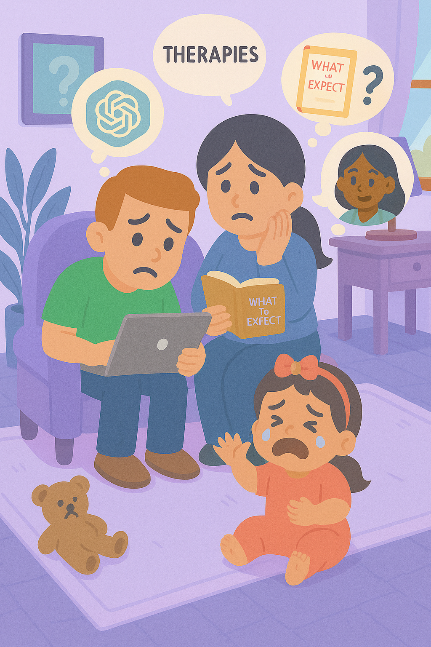
Typical guides fall short
There are many parenting books and guidelines on the market
But typical parenting guides don’t fit every child.
Especially when a genetic condition is in the picture.

Slide 3
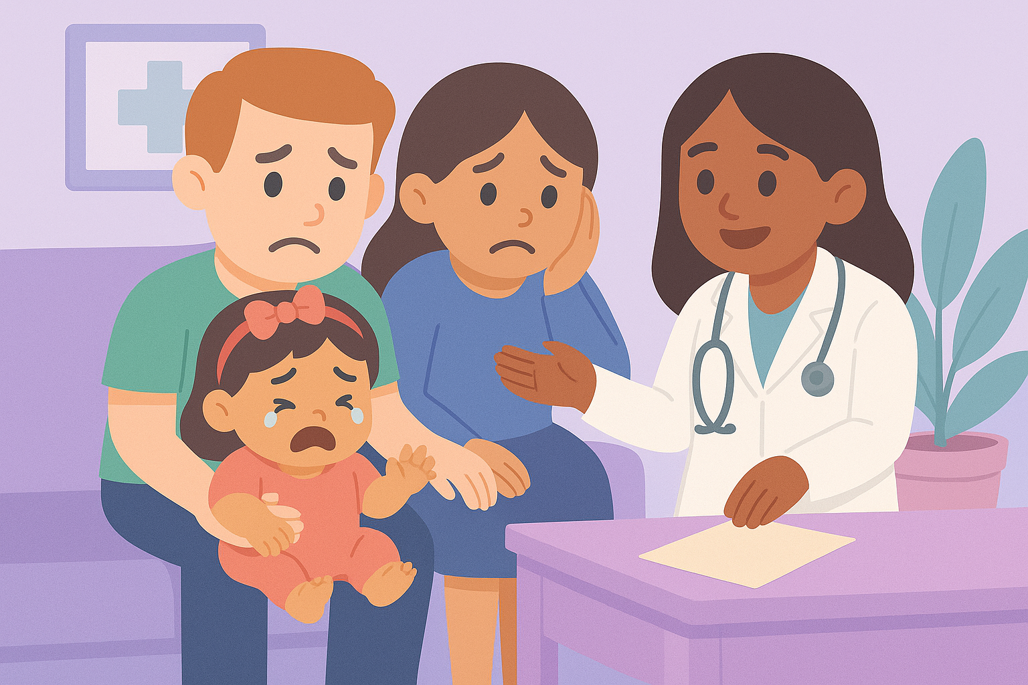
Diagnosis… then what?
For millions of families navigating genetic or developmental conditions
Guidance is fragmented
Routines are hard to follow
and support often feels out of reach.
Notes:
Voice Over: Millions of families are navigating genetic or developmental conditions. Parents leave hospitals with a diagnosis—but no Tuesday plan.
The guidance is fragmented, routines are hard to follow, and support often feels out of reach.

Slide 4

That’s why we built Genex

Slide 5
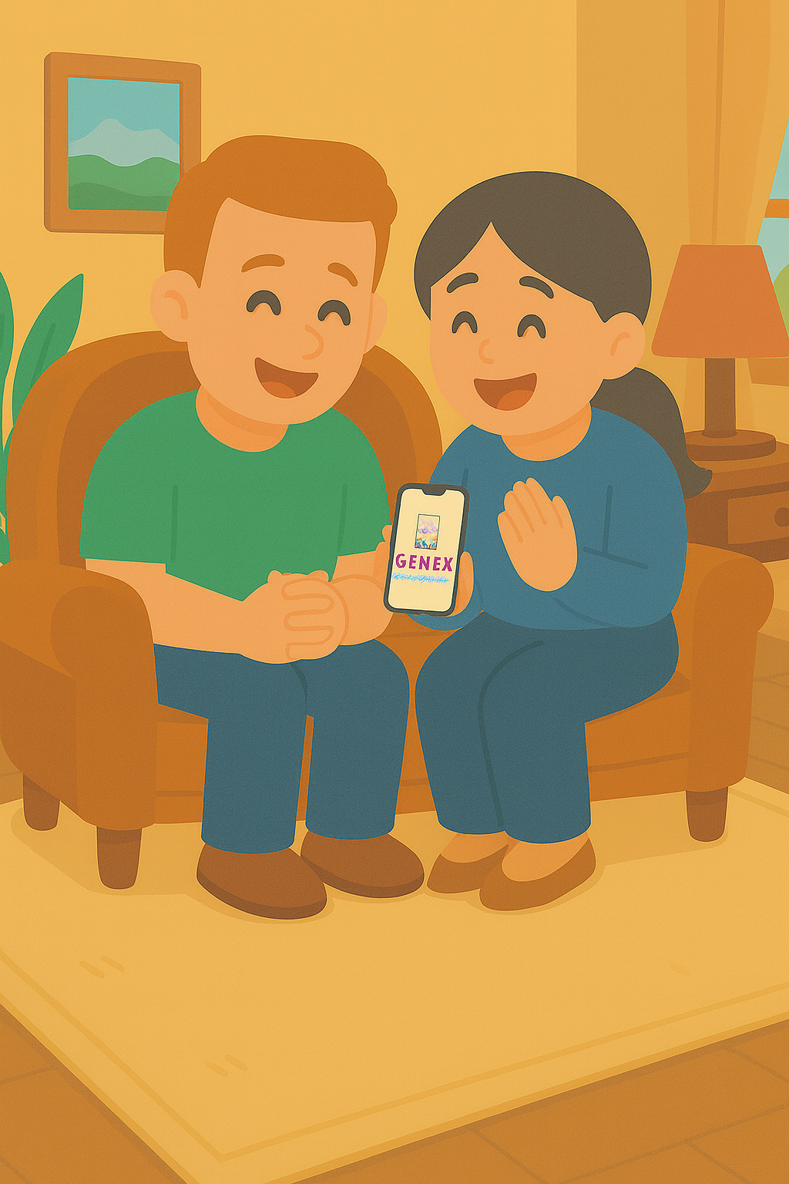





Genex – Genetics Made Practical
That’s why we built Genex
A privacy-first app
That uses generative AI
And based on your child’s needs
Builds clear, daily, bite-sized activities
You can actually use it at home and at school
Notes:
Plot: 1. The text comes first 2. after the first line “we built genex” (said by voice over) , the logo of Genex appears. 3. when voice over saying based on your child’s needs then the icons start appearing one by one until the end.
Voice over: That’s why we built Genex! A privacy-first app that uses generative artificial intelligence and, based on your individual child’s needs and diagnosis, builds clear, daily, bite-sized activities you can actually use at home and at school.

Slide 6
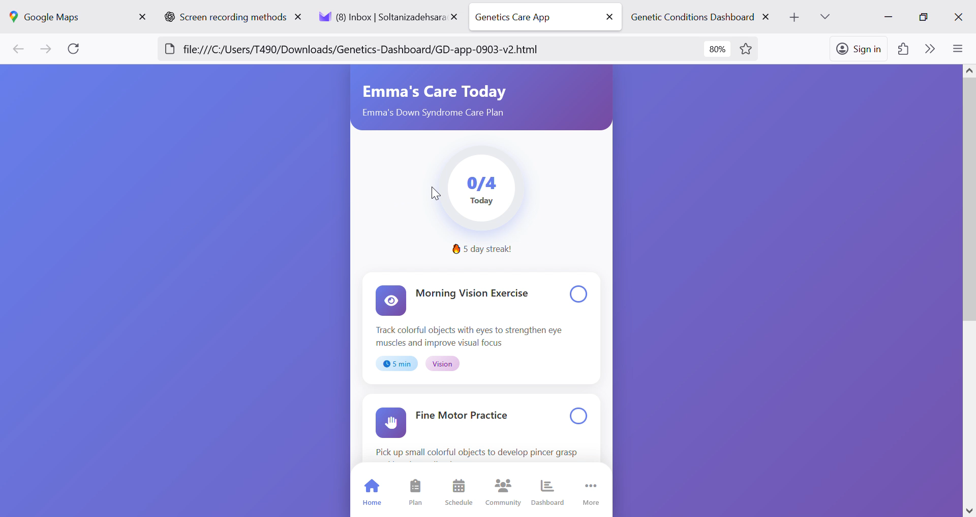
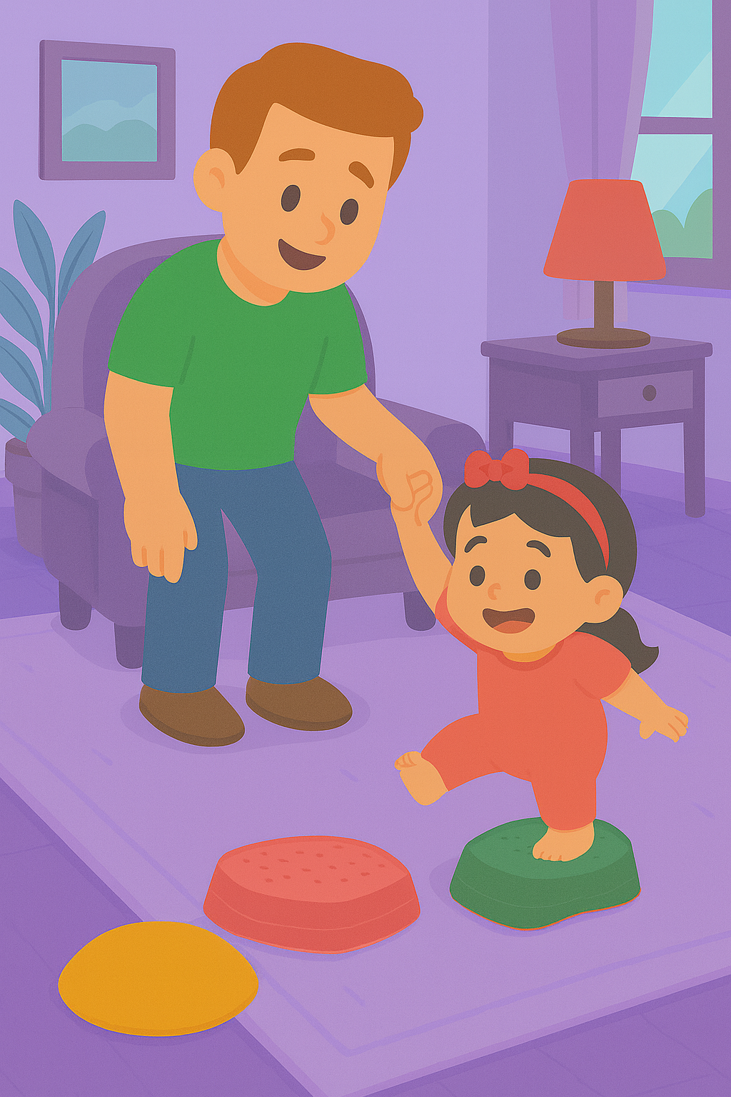
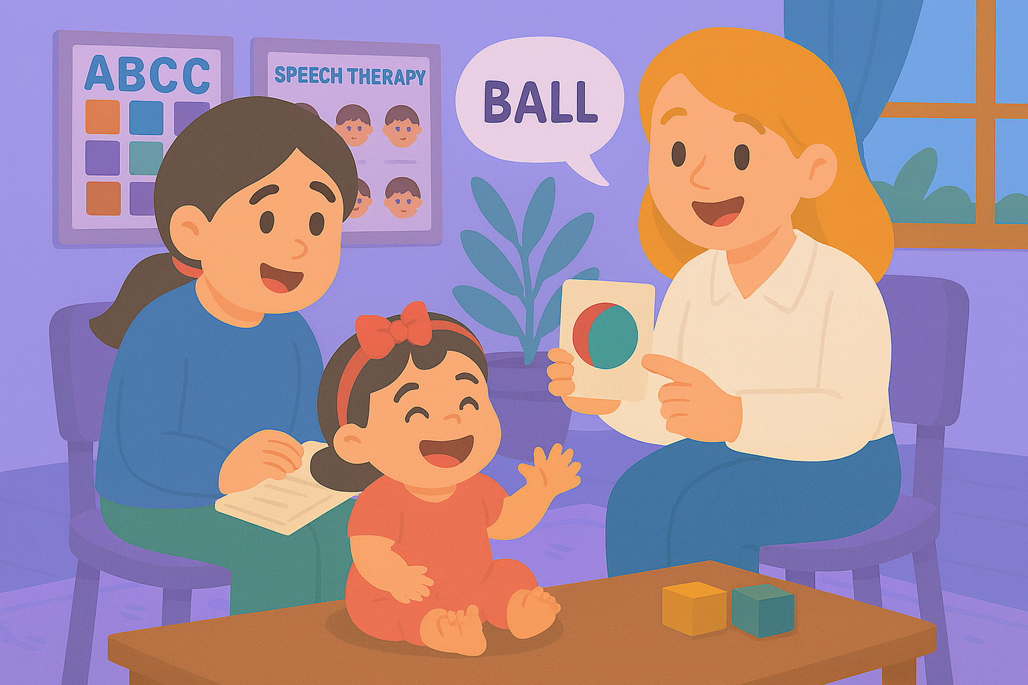
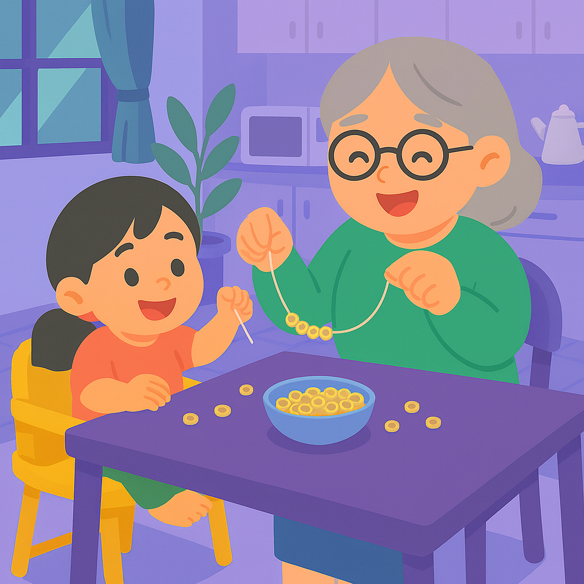
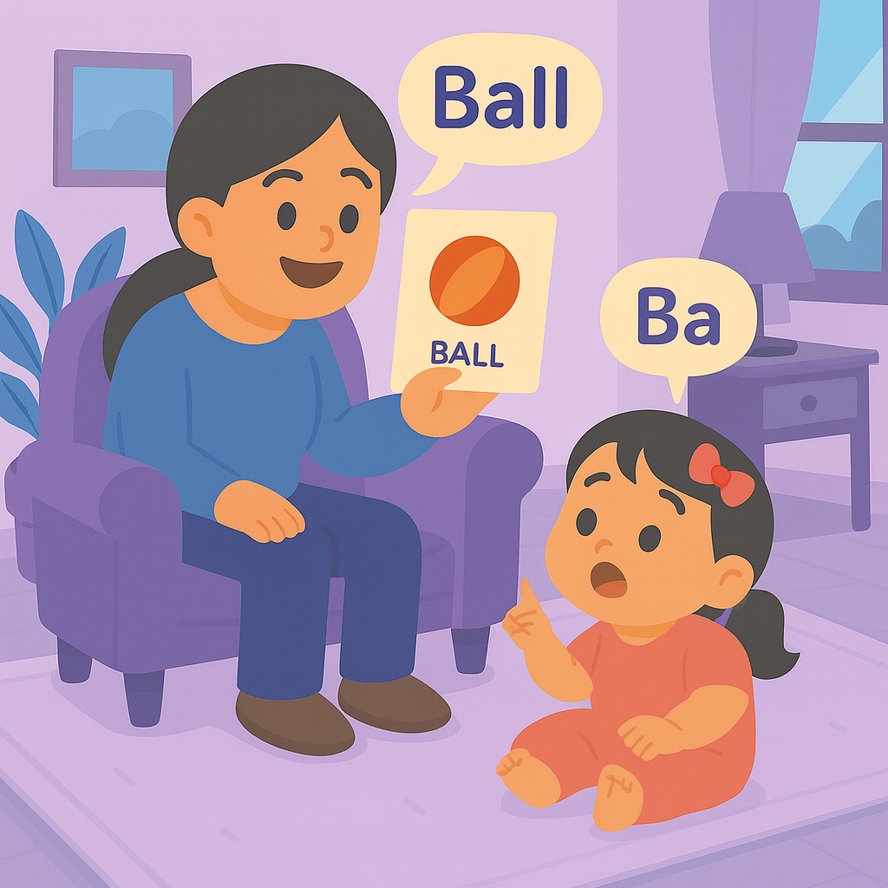

Genex – App
With curated:
5–10 minutes exercises
gentle reminders
progress tracking
community support
Helps:
families gain confidence
schools stay aligned
and children get consistent help - every day.
Notes:
Plot: The video plays and voice go over the voice over at the same time.
Voice over:

Slide 7
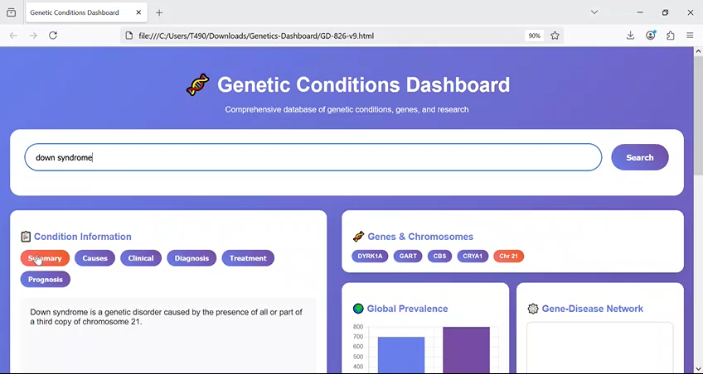
Genex – Dashboard
With:
Search and condition cards with source and confidence
At a glance visuals
Research lens including centers and top clinicians
Helps:
Families understand their child’s situation better
Know what to ask your doctor
Providers give feedback and modify suggestions
Notes:
Plot: The video plays and voice go over the voice over at the same time.
Voice over:

Slide 8
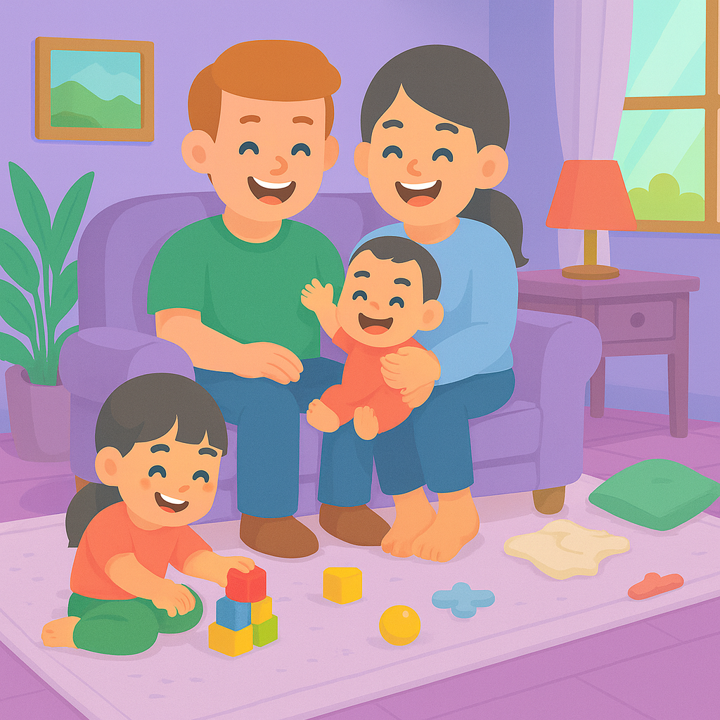
Genex – Dashboard
With:
Evidence-tagged condition panels
Knowledge graph-powered gene chips and relationships
And many more features like data exports and expert in the loop feedback
Helps:
Clinicians and providers can co-create the plan
Keep home and school on the same page
Notes:
Plot: The video plays and voice go over the voice over at the same time.
Voice over:

Slide 9
Together, we make care simpler, smarter, and supportive.
GeneX
Genetics Made Practical
Notes:
Plot: The test come one word at a time, and then Genex logo appears.
Voice over: Together we make care simpler, smarter and supportive. Genex, Genetics made practical.

Slide 10
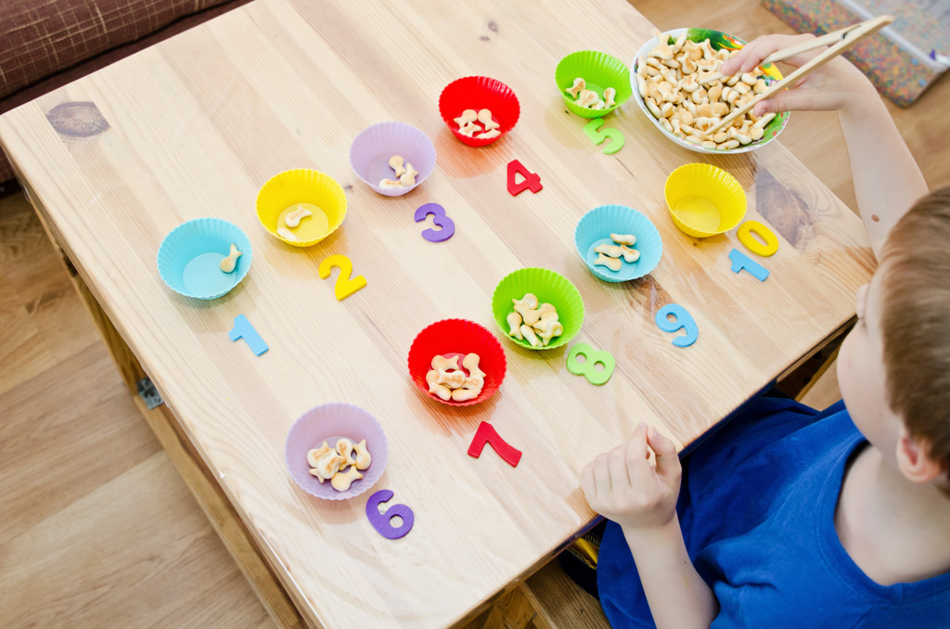

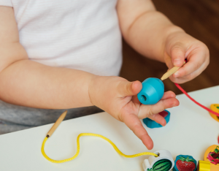
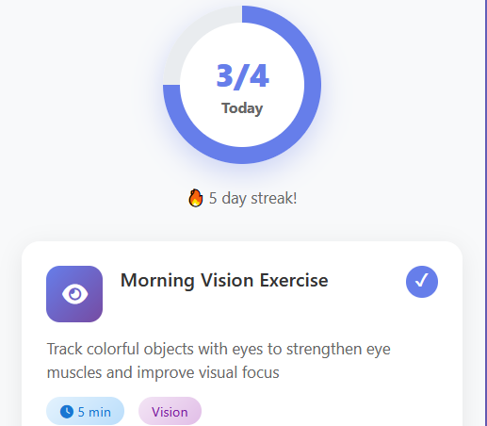

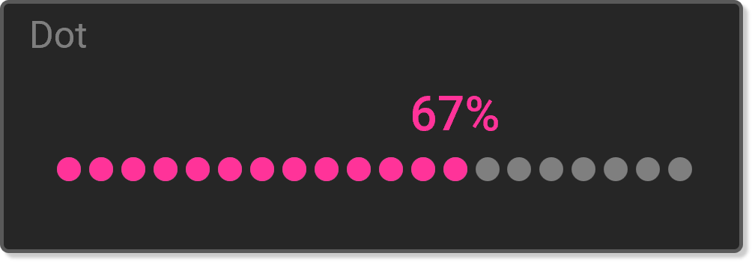
Notes:
With curated 5–10 minute exercises, reminders, progress tracking, and community support, families gain confidence, schools stay aligned, and children get consistent support — every day.

Slide 11





Notes:
"Together, we make care simpler, smarter, and supportive. GeneX — your genetics-aware care companion

